Slide 1
Control Flow Guard (CFG)
CSC 840 – Spring 2016
Josh Stroschein

Slide 2
Why I care
Dissertation research is focused on reverse engineering and security vulnerability discovery
CFG is latest efforts by Microsoft to reduce attack surface in Windows Operating System
How effective is CFG?

Slide 3
Three Main Ideas
How does CFG work? What is the difference between a binary using CFG and those that are not
Is CFG effective?
What gaps does it fill in exploit mitigation?
Are there ways to bypass CFG?
What gaps does it not feel or leave behind?
More security research can focus on this area

Slide 4
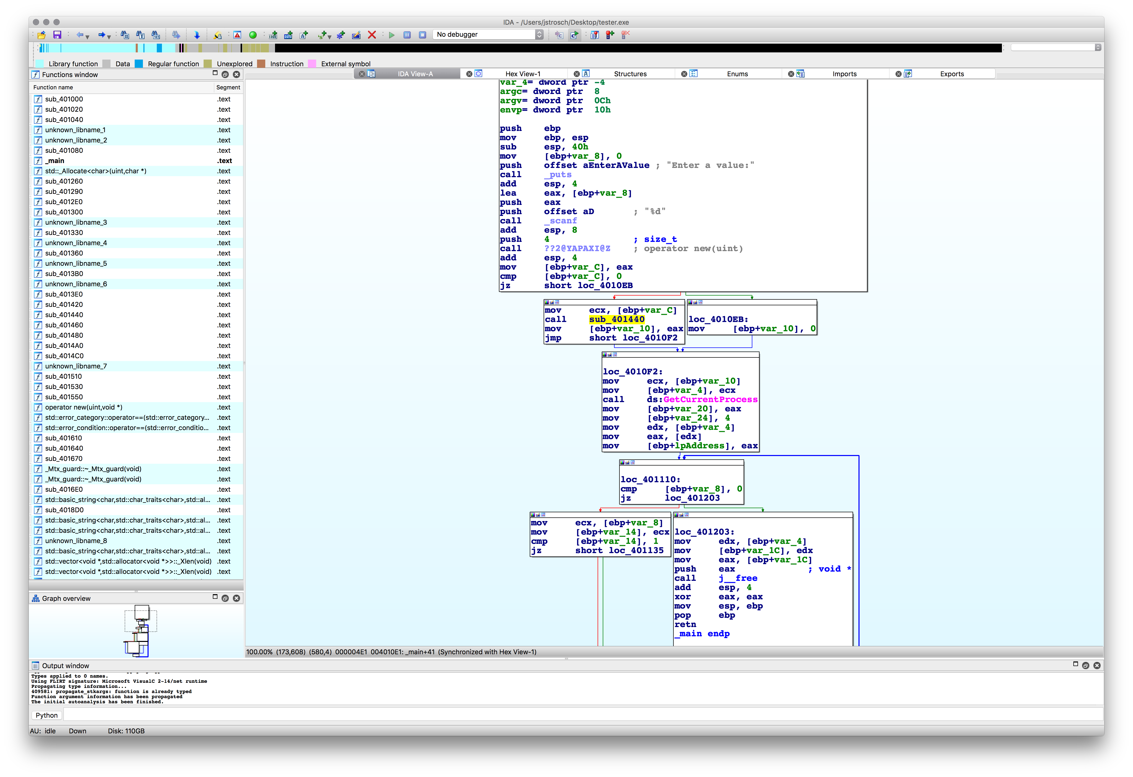
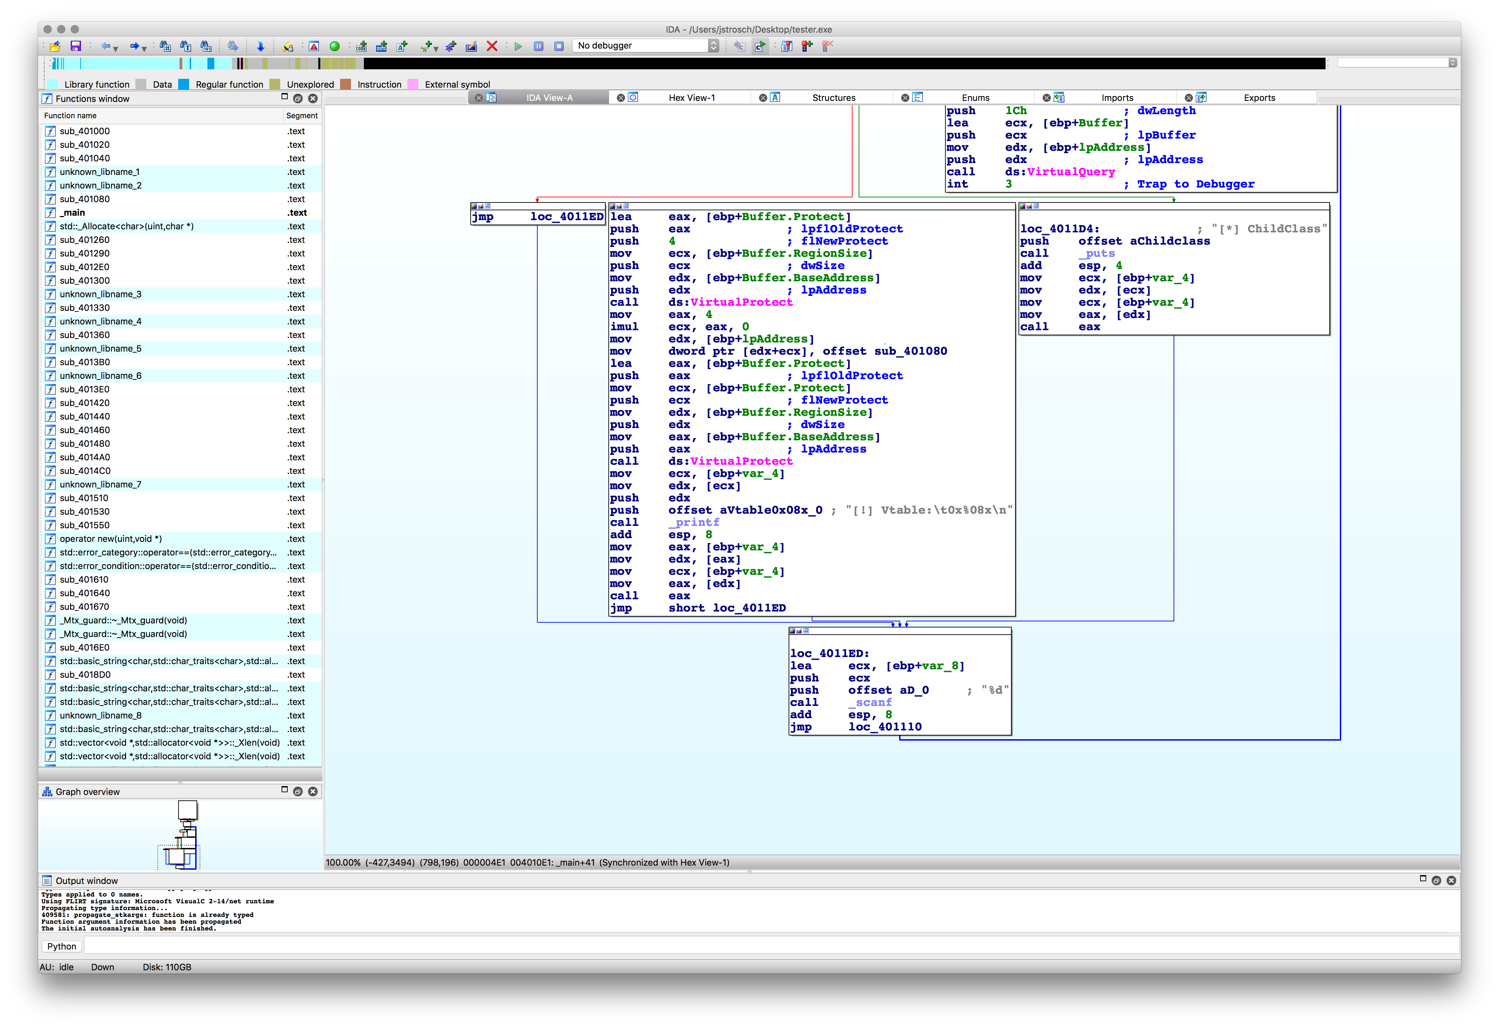
Indirect Calls
’Normal’ call – address is determined when program is compiled
This can be checked
Indirect – address is determined at runtime
This can be abused

Slide 5
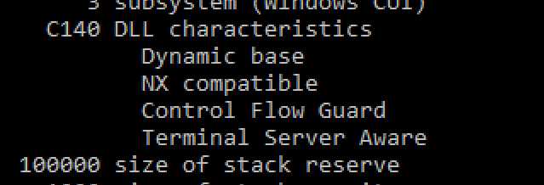
Control Flow Guard (CFG)
Introduced with Windows 10 and Windows 8.1 Update 3
Goal is to address ’gaps’ left by protections like DEP and ASLR
To be implemented, compiler and OS have to support
When building a program, tell compiler/linker to use
cl /guard:cf test.cpp /link /guard:cf
How to tell if binary is using CFG?
You can use dumpbin – dumpbin /headers /loadconfig test.exe

Slide 6
How does CFG work?
Identifies every location (site) where an indirect call is made
Injects a check – before every indirect-call is made makes sure that the address is expected
If this check fails, so does the program
How is this abused?
Attacker supplies address to call for value in EAX
Indirect call

Slide 7
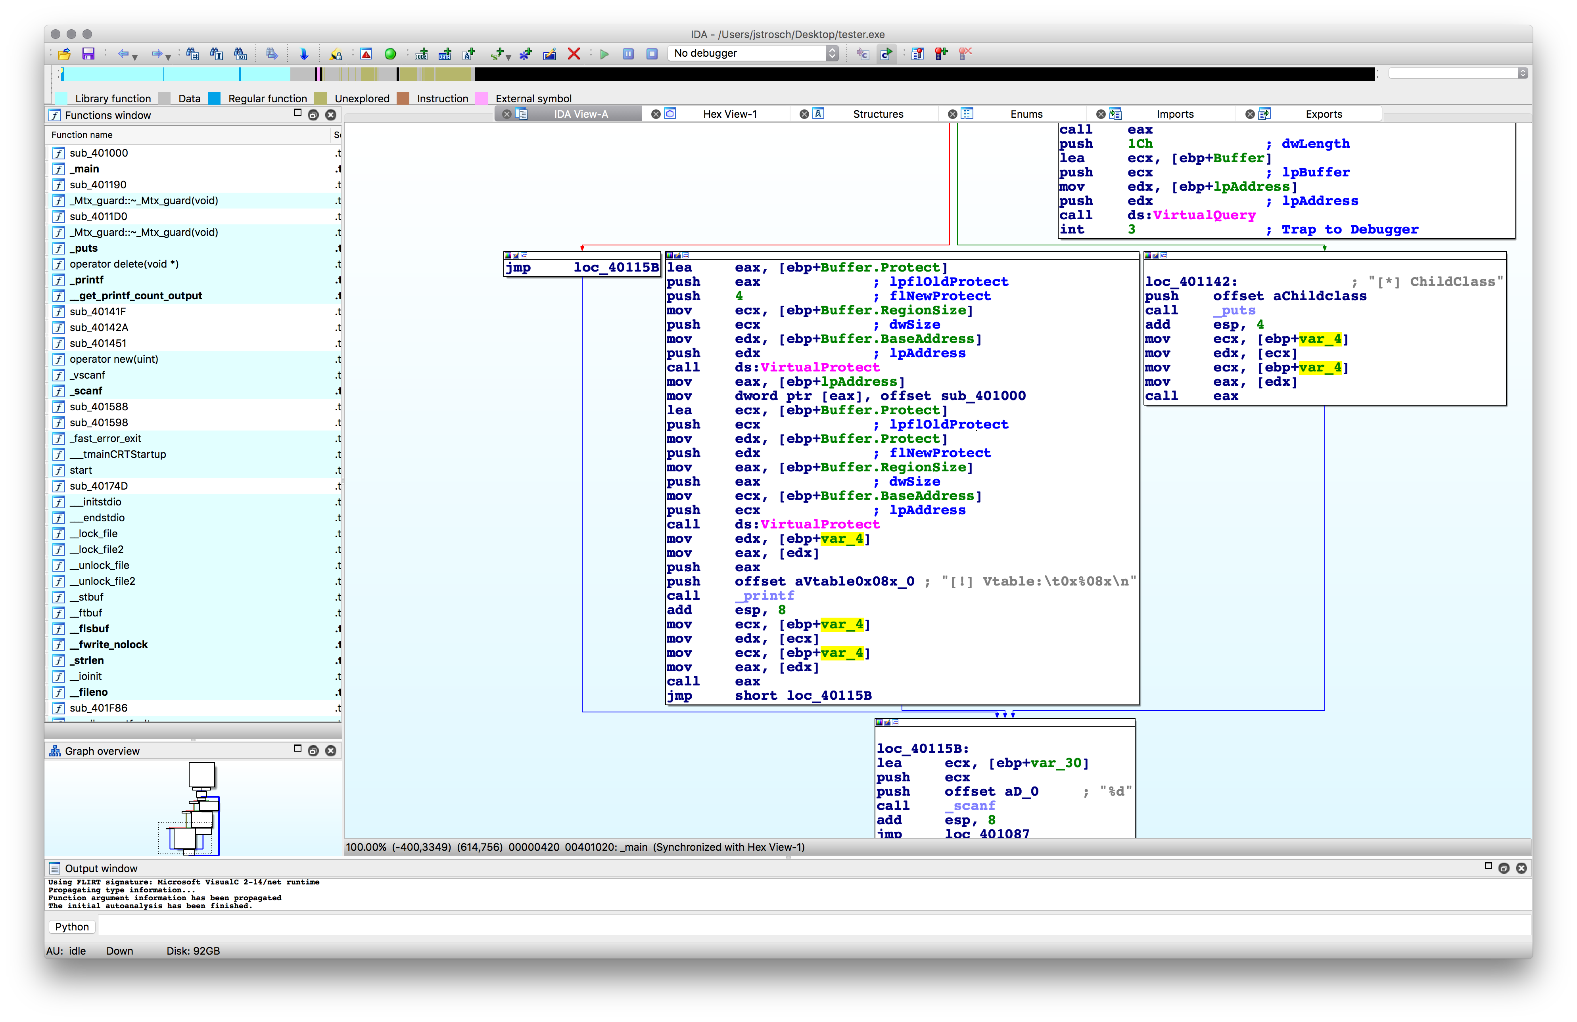
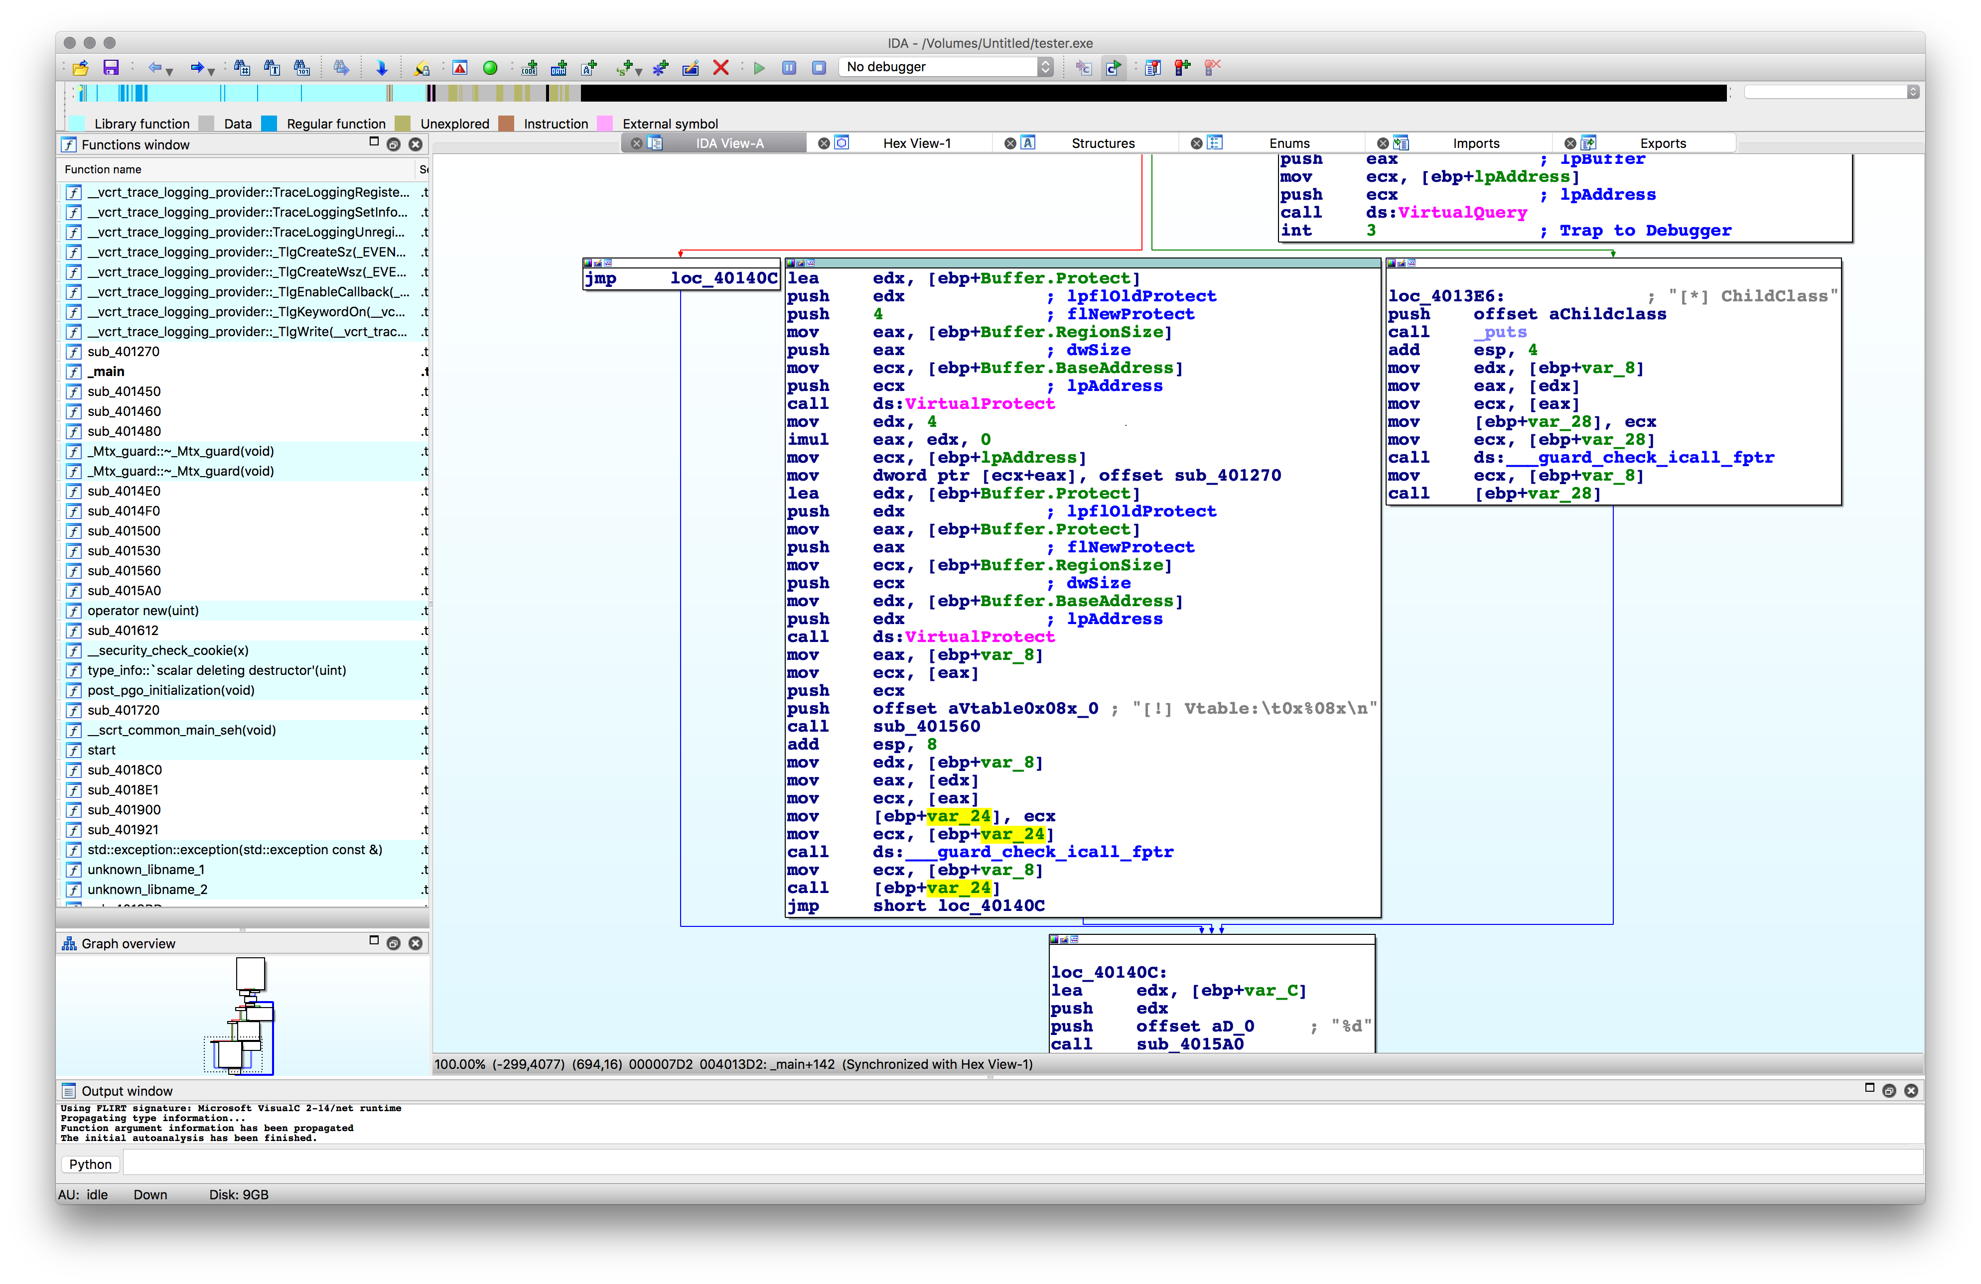
How Does CFG Work?
Without CFG
With CFG
The target location is checked before the call is made

Slide 8
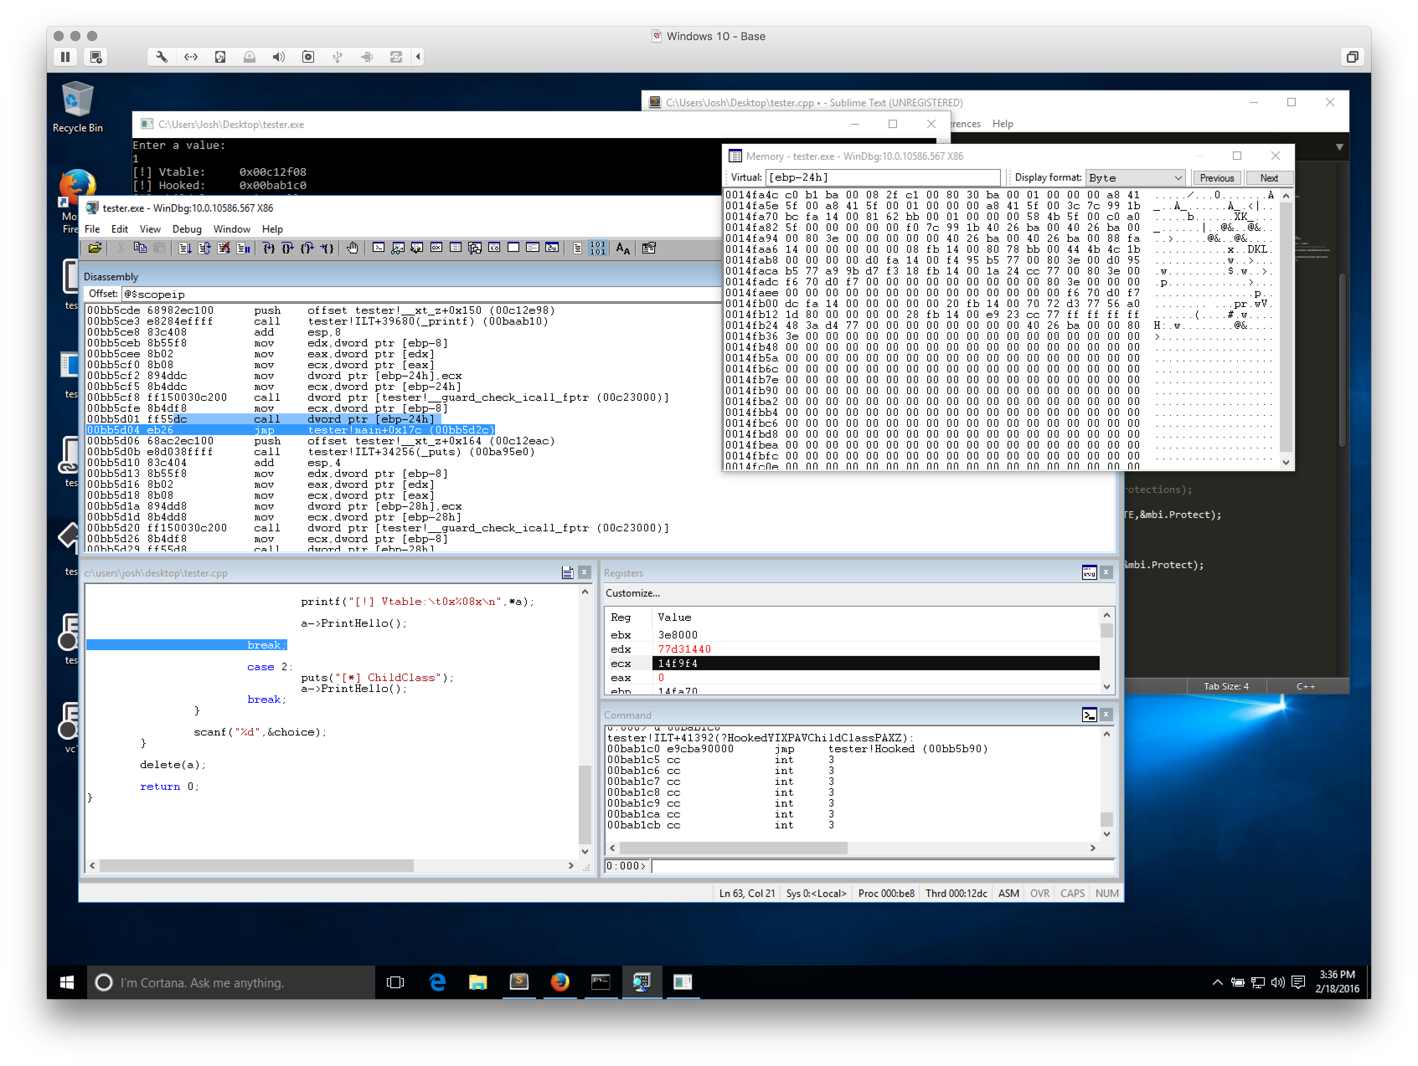
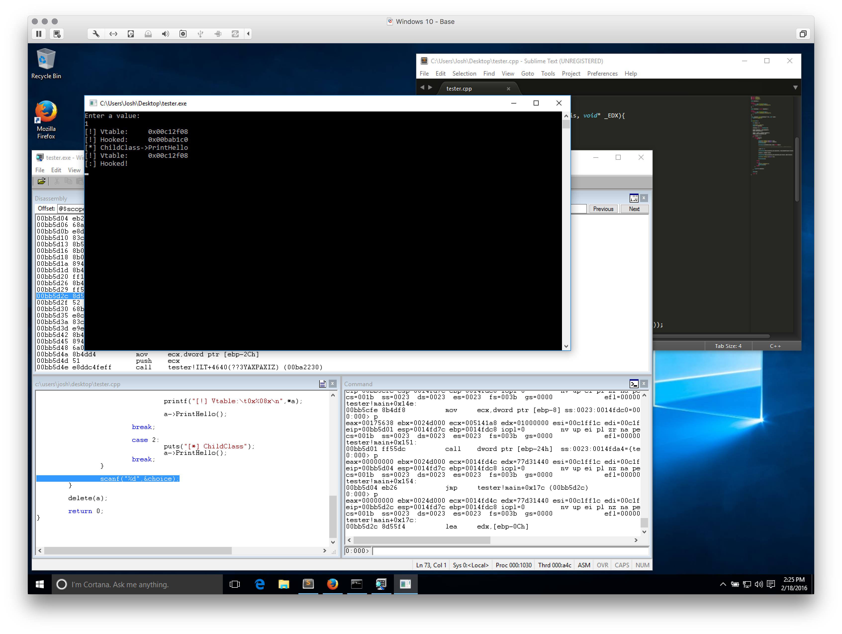

Testing CFG
With Hooking & CFG

Slide 9
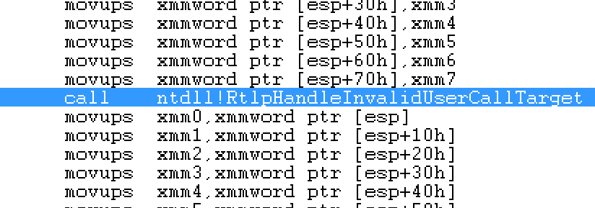
Testing CFG
Hooking Attempt – Call to VirtualAlloc
Demo will cover setup

Slide 10
CFG Target Addresses
A bitmap is created
This bitmap represents the starting location of functions in process space
What this means
There isn’t a one-to-one mapping of all valid call sites
This allows for exploitation still – if you can find what you need
Return sites are not checked either…

Slide 11
Future Direction
Understand how the CFGBitmap is created
Impact this has on the effectiveness of CFG
Explore other avenues of bypass for CFG
Can I get working ROP?
What else could be created to fill “gaps” left by CFG?

Slide 12
Resources
Control Flow Guard: http://blog.trendmicro.com/trendlabs-security-intelligence/exploring-control-flow-guard-in-windows-10/
Dumpbin: https://msdn.microsoft.com/en-us/library/c1h23y6c.aspx
Intro to CFG: https://blogs.msdn.microsoft.com/vcblog/2014/12/08/visual-studio-2015-preview-work-in-progress-security-feature/

